Slide 1
Social Investment in Prince George County Through IT Bootcamps for Low Income Women Of Color
INFM 600
Boricha, Tadele, Yang

Slide 2
Social Investment
Social investment is the use of repayable finance to achieve a social as well as a financial return. Effective social investment helps a business to achieve its social, economic or environmental impact in a sustainable way, so that it may eventually become self-sufficient.

Slide 3

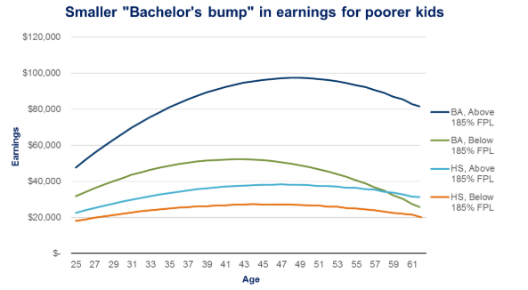
With the high demand for a diverse and inclusive technical workforce, how can local and state government increase the quality of life and/or socioeconomic status for women of color though strategic partnerships (I.e. grants, scholarships, stipends) with coding boot camps in the Washington metro area?

Slide 4
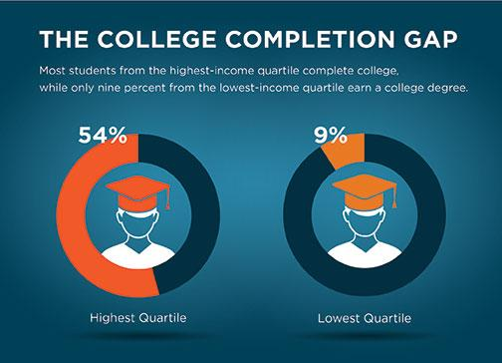
Aims:
To effectively highlight the need, benefit, and impact of social investment through IT education for low income women of color in Prince George's County.
Barries:
The existent gender and racial inequality prevalent in the IT field leads to a stark difference in employability and income levels between privileged groups and marginalized groups.
Women of color especially come down to the bottom of the heap when it comes to opportunities to be part of the this booming white-collar high-paying tech industry.
Solution:
In effort to proposing a solution that would essentially make these jobs accessible to low income women of color through IT Bootcamps in PG County as a sustainable and cost effective way to subsidize government assistance.
Notes:
This report aims to effectively showcase the existent gender and racial inequality prevalent in the field of Technology which leads to a stark difference in employability and income levels between privileged groups and marginalized groups. And especially women of color are come down in the bottom of the heap when it comes to opportunities to be part of the this booming white-collar high-paying tech industry. Our project aims at firstly identifying and confirming that this problem exists through stats and figures and then proposing a solution to essentially make these jobs accessible to women of color through IT Bootcamps in PG County
This report aims to effectively highlight the need, benefit, and impact of social investment through IT education for low income women of color in Prince George's County. The existent gender and racial inequality prevalent in the IT field leads to a stark difference in employability and income levels between privileged groups and marginalized groups. Women of color especially come down to the bottom of the heap when it comes to opportunities to be part of the this booming white-collar high-paying tech industry.
Our project aims to:
Identify Maryland’s 24 counties socioeconomic characteristics to highlight the potential of social investment in PG County,
Analyze Montgomery County education and tuition assistance program as a point of reference
Examine occupations employment, projections, labor force participation, and educational certificates and licenses in IT related fields in order to justify investment in IT education
In efforts to proposing a solution that would essentially make these jobs accessible to women of color through IT Bootcamps in PG County as a sustainable and cost effective way to subsidize government assistance.

Slide 5
Our Project Goals:
Identify Maryland’s 24 counties socioeconomic characteristics to highlight the potential of social investment in PG County,
Analyze Montgomery County education and tuition assistance program as a point of reference
Examine occupations employment, projections, labor force participation, and educational certificates and licenses in IT related fields in order to justify investment in IT education

Slide 6
Why is this important?

Slide 7
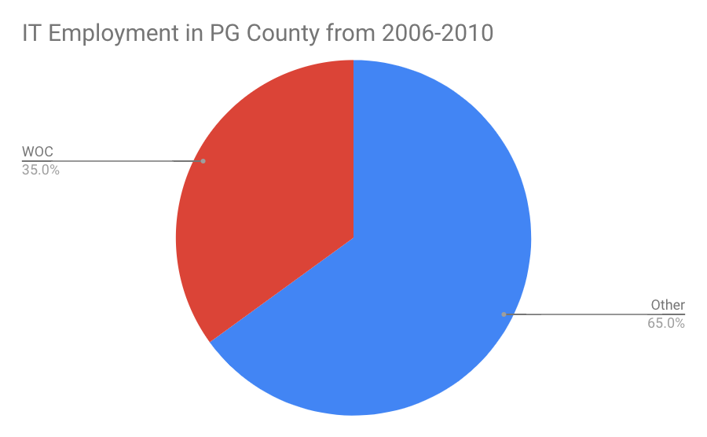
Women of Color are Being Left Out
It is painfully obvious that women of color are being left out of such a robust, high paying and key labor force. From 2006 to 2010 women of color only made of 35% of the workforce in IT related fields in PG County even tho they make up more than half the population
The poverty gap is increasing in PG County, especially for women of color. (Frame the problem for the audience. )
Both men and white women make x% more than the average WOC (Quantify the scope of the problem and connect it to your audience.)
Notes:
From the graph, it is clearly visible that tech jobs with focus in CS/IT/Data Science in Prince George’s County more men are employed then women. Also, we know from our dataset that proportion of men and women for all races in PG County is a nearly 50-50 split. Since our focus have been women of color we can infer from the above graph that women of color are underrepresented in these tech roles and therefore our idea of making accessible bootcamps for them with help of government and NGO’s can be of significant help. We have made use of ggplot2 to get this visualization. Also, a lot more goes into this because we were asked to include a key/legend. We have therefore added a legend for showing the color code for men and women.

Slide 8
Who should care?

Slide 9
Stakeholders
Federal Government
Local & National Businesses with Tech Needs
Local & National Nonprofits
Local & State Government Officials
Local Low-Income Residents
Maryland State Government
Prince George’s County
The City of College Park

Slide 10




Answer the “who” question
Janet
Ronny
Abby
Marcus
Janet is a 23 year old single mom who works in retail. She has a high school diploma and 2 semesters in community college but she dropped out. She wants to go back and get an education that will give her much more opportunities for her and her son. She has no strong IT background but is very interested in learning.
Ronny is a Tech Consultant and teaches at UMUC’s bootcamp, Revature. He is passionate about bridging the gap in gender, race, and socioeconomic status in the IT field. A first generation American and a PG County native, he is an advocate for IT education in underserved communities.
Abby is a coordinator at UMUC for the Revature bootcamp program. She is working to make the program accessible for low income women of color through partnering with PG County’s Department of Social Services. She knows how effective and impactful Revature’s program is and is excited to have local women.
Marcus is a county official for PG County in the Department of Social Services. He wants to tackle the poverty rate for women of color in a creative cost-efficient way that has a high ROI. He recently got a IT certificate from UMUC and realized the potential of such an education.

Slide 11

Revature’s Bootcamp Model
Recruit
We’re selective about our technology talent, recruiting the top 1% from colleges and universities throughout the country.
Develop
Through our intensive coding immersion programs, we turn web developers into world-class software engineers.
Deploy
We deliver job-ready technology talent fast, cutting down onboarding time so you can focus on your project’s success.
Hire
Our talent seamlessly integrates with existing technology teams so well that they end up being hired by clients.

Slide 12
Where the data come from

Slide 13

Maryland Department of Planning
The first dataset from the MDP highlights Maryland’s 24 counties socioeconomic characteristics in 40 categories that include total households, population age, education levels, employment levels, median household incomes, race, and gender. While the second is a EEO Report highlights PG’s civilian labor force by sex and race.

Slide 14

Montgomery County
The data set from Montgomery County (2018) highlights education and tuition assistance in the county. The dataset, which is updated twice a year, includes a list of classes approved and paid through the County tuition assistance program, the title and description of the course, the school the course will be taken at, the degree this class curriculum is a part of, the Department and title of the requester, the dollar amount reimbursed to the employee.

Slide 15

Bureau of Labor Statistics
We collected 3 datasets from the Bureau of Labor Statistics spotlight 2016 and projected 2026 employment by major occupational group, employment by detailed occupation, and fastest growing occupations.

Slide 16
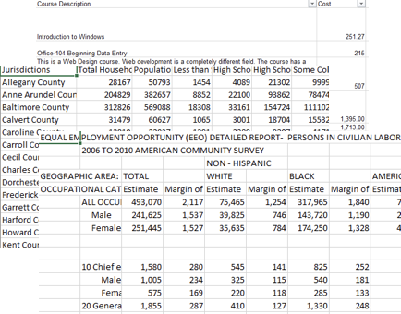
Explore the Raw Data
Our data has various metrics
Since a plurality of our datasets come from government records and websites they are comparatively a lot cleaner but there have been obvious data issues like NA values, missing values, non-standardized datavalues

Slide 17
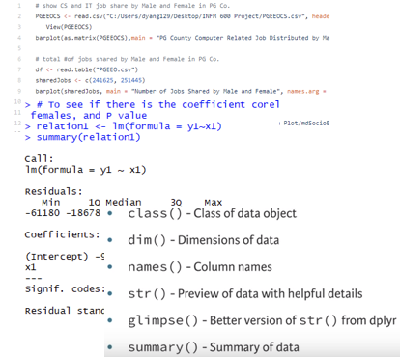
Data Cleaning
Understanding the structure of data
Looking at the data with an eye for discovering new patterns, correlations and insights
Visualization of data

Slide 18
How we used the data

Slide 19

Identified
Identified Maryland’s 24 counties socioeconomic characteristics to highlight the potential of social investment in PG County
Notes:
The dataset Maryland Department of Planning, Maryland Counties Socioeconomic Characteristics include all counties in Maryland. We select a few columns that make helps to illustrate the necessity of boot camp for lower income people and minority who do not have resources and would like to enhance they capability in job market.
This should probably just be an infographic about WOC in PG County. This will help us build a profile for the potential need in PG for WOC to do this Bootcamp classes.
Then we will compare those same factors (Total Households, Employment Status of the Population 16 years and over, Employed, Unemployed, Unemployment Rate, Median Household Income ($), Percent Families in Poverty) to the rest of the counties as a whole. This will help with our argument that PG is a great place to do this because of its the demographics compared to all the rest of Maryland counties.

Slide 20

Analyzed
Analyzed Montgomery County Education and Tuition Assistance Program as a point of reference of IT related majors for a certificate and non-degree programs
Notes:
MAJOR
Computer Science
Computer Systems Management
Information Technology
Professional/Technical
DEGREE
Certificate
Other
Non-Degree
BEGINNING WORD PROCESSING CMSY 102
COMPUTER BASICS
WEB DESIGN CERTIFICATE
NETWORK ENGINEER ALL ACCESS TRAINING
ACHIEVING ITIL� FOUNDATION CERTIFICATION
SEC401 - SANS SECURITY ESSENTIALS BOOTCAMP
FUNDAMENTALS OF NETWORKING
COMPTIA A +, NETWORK +, AND SECURITY + BUNDLE ONLINE COURSE
FOR585 ADVANCED SMARTPHONE FORENSICS
ISE 5200-HACKING TECHNIQUES AND INCIDENT RESPONSE
CISCO ADVANCED ROUTING AND SWITCHING TECHNOLOGIES: INTERNETWORKING 3
CISCO PROJECT-BASED LEARNING: INTERNETWORKING 4
CISCO NETWORKING FUNDAMENTALS: INTERNETWORKING
CISCO NETWORKING ROUTER TECHNOLOGIES: INTERNETWORKING 2
SCIENTIFIC EVIDENCE AND THE RIGHT TO CONFRONTATION
WORLD RELIGIONS
ITE 115 - INTRO COMPUTER APPL/CONCEPTS
ITN 100 - INTRO/TELECOMMUNICATIONS
ITN 260 - NETWORK SEC. BASICS
ITE 221 - E80W PC HARDWARE & O/S ARCHITECTURE
WEB AND SOCIAL MEDIA DESIGN INTRODUCTION
SOCIAL MEDIA NETWORKING - CREATE AND EFFECTIVELY MANAGE A FACEBOOK SITE
COMPUTER PUBLISHING - INTRODUCTION TO PHOTOSHOP
CISCO CCNA

Slide 21

Examined
Examined occupations employment, projections, labor force participation, and educational certificates and licenses in IT related fields in order to justify investment in IT education

Slide 22
Interpretation of the data

Slide 23
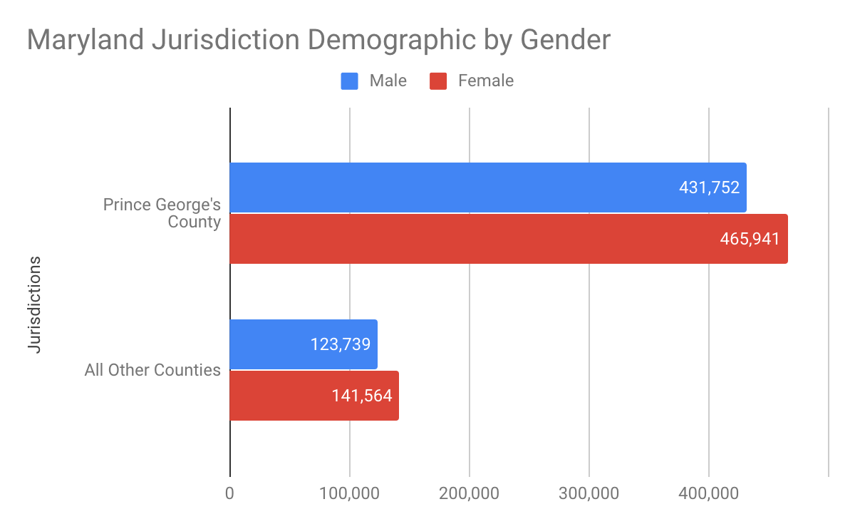
Maryland Department of Planning
Maryland Counties Gender Characteristics.
51% of people in PG county Women
Average population in MD county is 274,304
53% of MD’s population are people of color
Notes:
51% of people in PG county Women
52% of MD’s population are people of color
Average population in MD county is 274,304

Slide 24
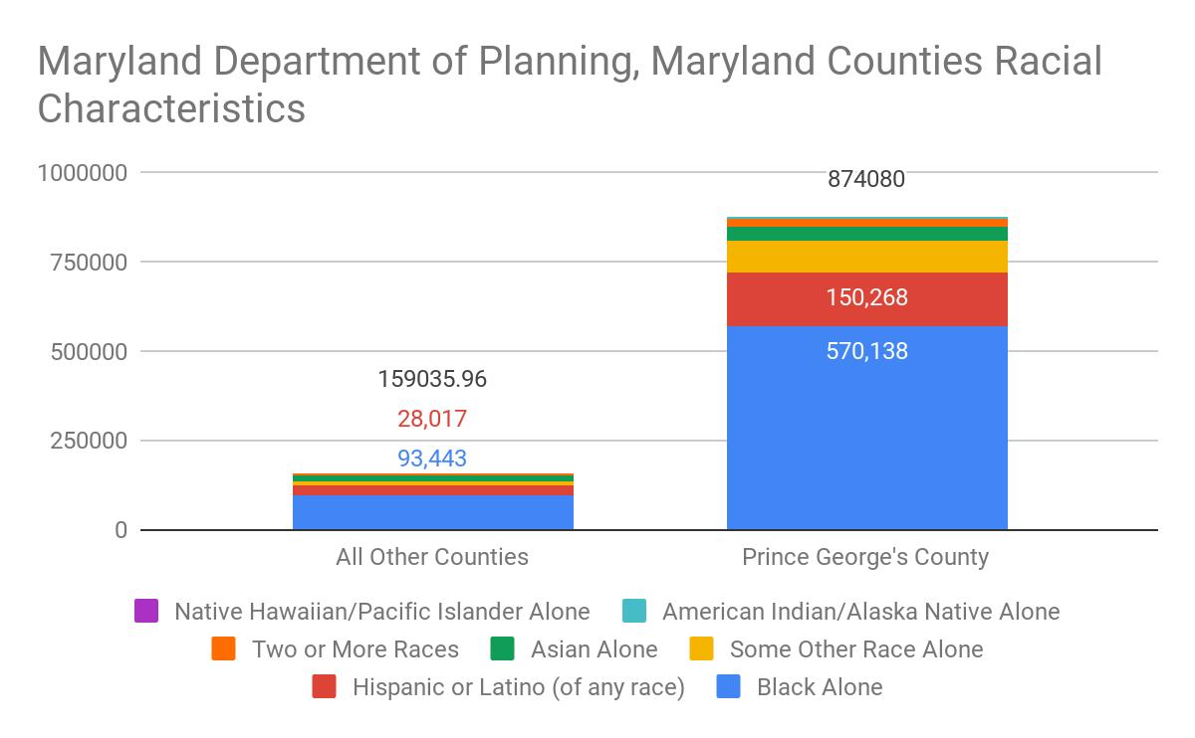
Maryland Department of Planning
Maryland Counties Racial Characteristics
PG County is 83.4% people of color, the most diverse county in Maryland
Notes:
Here we are comparing the percentage minority population of various counties to highlight were PG County stands in comparison to others. It is clear that PG county is by far the most diverse in terms of minority percentage in overall population at a staggering 83.4%. The next closest comes at 71.1% which is more than 10 points less than PG County. Other counties have even fewer minority populations. Once again, this bar graph reaffirms our decision to choose PG County as our county of focus.
The bar graph shows us the racial demographic makeup of PG county. So why did we choose PG County for our analysis? This graph answers that question. Our area of focus was women of color. An clearly women from minority background make up a majority of the population and therefore helps in our goal of making them have better access to online technical courses and bootcamps.

Slide 25
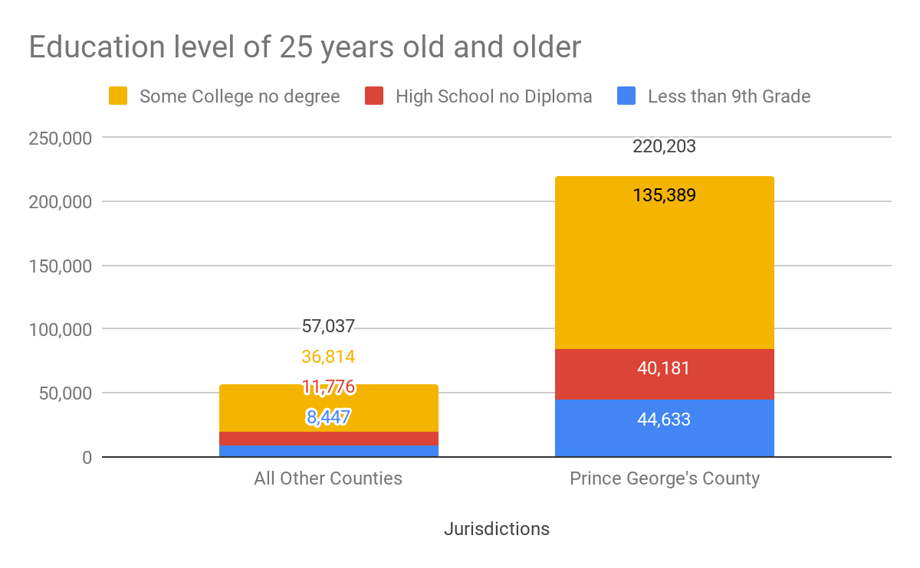
Maryland Department of Planning
Maryland Counties Educational Characteristics.
64% of PG County population over the age of 25 have some college experience but no degree

Slide 26
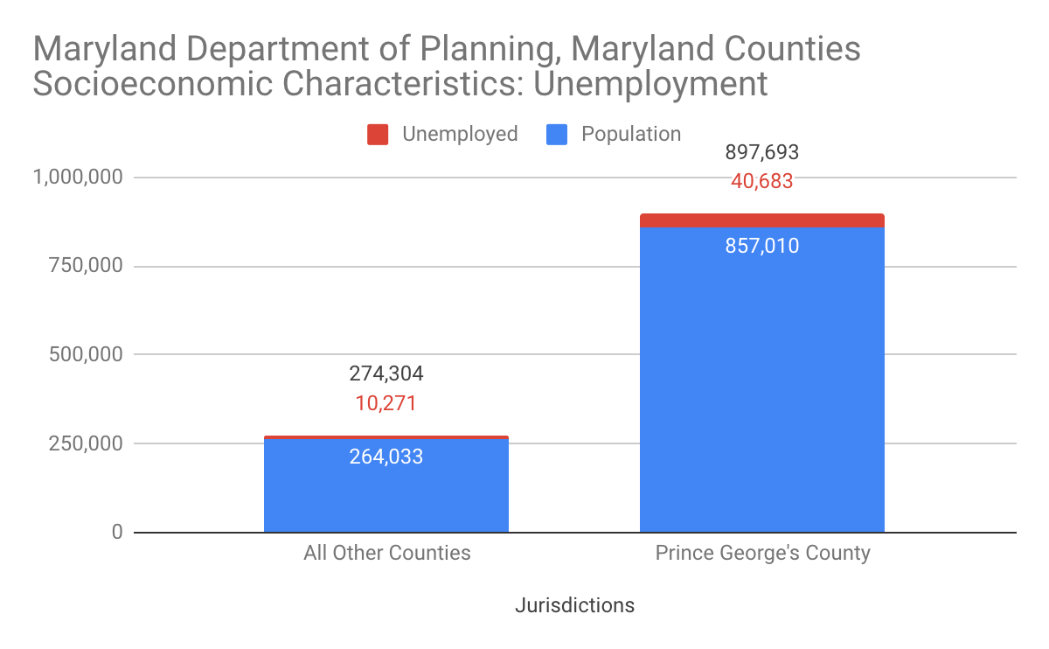
Maryland Department of Planning
Maryland Counties Economic Characteristics: Employment
8% of PG population is unemployed
Average percentage of unemployed population in MD countie is 6.7%
Notes:
All Other Counties have a 6.7% of its population unemployed
8% of PG population is unemployed

Slide 27
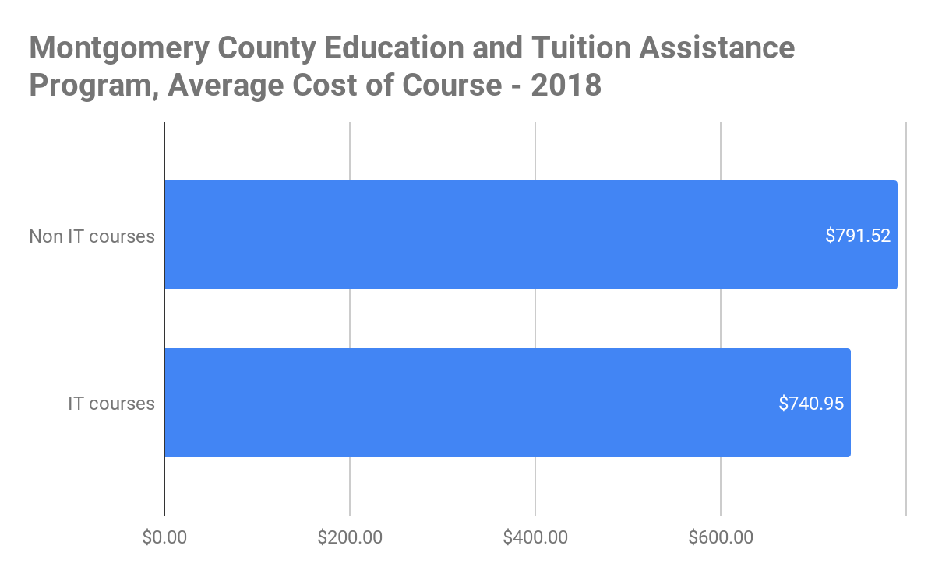
Cost of non-IT courses vs IT courses
Non Tech courses cost $50 MORE than technical courses
Montgomery County Education Tuition Assistance Program
Total amount spent on tuition assistance for IT courses is $16,400 in 2018
5 Departments requested T.A. (Correction & Rehabilitation, Health & Human Services, Housing & Community Affairs, Technology Services, Transportation
Notes:
Analyzing Montgomery County Education and Tuition Assistance Program we found that computer/data science related courses actually cost lesser. This further strengthens our idea of promoting these online computer/data science related courses even if there is no funding from Government or NGOs in case.
Which departments requested tuition assistance?
Correction & Rehabilitation,
Health & Human Services,
Housing & Community Affairs, ,
Technology Services,
Transportation
Total sent was $16,400

Slide 28
IT Related Courses Taken Through MoCo Ed & Tuitions Assistance Program in 2018
1. BEGINNING WORD PROCESSING CMSY 102
2. COMPUTER BASICS
3. WEB DESIGN CERTIFICATE
4. NETWORK ENGINEER ALL ACCESS TRAINING
5. ACHIEVING ITIL FOUNDATION CERTIFICATION
6. SEC401 - SANS SECURITY ESSENTIALS BOOTCAMP
7. FUNDAMENTALS OF NETWORKING
8. COMPTIA A +, NETWORK +, AND SECURITY + BUNDLE ONLINE COURSE
9. FOR585 ADVANCED SMARTPHONE FORENSICS
10. ISE 5200-HACKING TECHNIQUES AND INCIDENT RESPONSE
11. CISCO ADVANCED ROUTING AND SWITCHING TECHNOLOGIES: INTERNETWORKING 3
12. CISCO PROJECT-BASED LEARNING: INTERNETWORKING 4
13. CISCO NETWORKING FUNDAMENTALS: INTERNETWORKING
14. CISCO NETWORKING ROUTER TECHNOLOGIES: INTERNETWORKING 2
15. ITE 115 - INTRO COMPUTER APPL/CONCEPTS
16. ITN 100 - INTRO/TELECOMMUNICATIONS
17. ITN 260 -NETWORK SEC. BASICS
18. ITE 221 - E80W PC HARDWARE & O/S ARCHITECTURE
19. WEB AND SOCIAL MEDIA DESIGN INTRODUCTION
20. SOCIAL MEDIA NETWORKING - CREATE AND EFFECTIVELY MANAGE A FACEBOOK SITE
21. COMPUTER PUBLISHING - INTRODUCTION TO PHOTOSHOP
22. CISCO CCNA
Notes:
BEGINNING WORD PROCESSING CMSY 102
COMPUTER BASICS
WEB DESIGN CERTIFICATE
NETWORK ENGINEER ALL ACCESS TRAINING
ACHIEVING ITIL FOUNDATION CERTIFICATION
SEC401 - SANS SECURITY ESSENTIALS BOOTCAMP
FUNDAMENTALS OF NETWORKING
COMPTIA A +, NETWORK +, AND SECURITY + BUNDLE ONLINE COURSE
FOR585 ADVANCED SMARTPHONE FORENSICS
ISE5200-HACKING TECHNIQUES AND INCIDENT RESPONSE
CISCO ADVANCED ROUTING AND SWITCHING TECHNOLOGIES: INTERNETWORKING 3
CISCO PROJECT-BASED LEARNING: INTERNETWORKING 4
CISCO NETWORKING FUNDAMENTALS: INTERNETWORKING
CISCO NETWORKING ROUTER TECHNOLOGIES: INTERNETWORKING 2
SCIENTIFIC EVIDENCE AND THE RIGHT TO CONFRONTATION
WORLD RELIGIONS
ITE 115 - INTRO COMPUTER APPL/CONCEPTS
ITN 100 - INTRO/TELECOMMUNICATIONS
ITN 260 - NETWORK SEC. BASICS
ITE 221 - E80W PC HARDWARE & O/S ARCHITECTURE
WEB AND SOCIAL MEDIA DESIGN INTRODUCTION
SOCIAL MEDIA NETWORKING - CREATE AND EFFECTIVELY MANAGE A FACEBOOK SITE
COMPUTER PUBLISHING - INTRODUCTION TO PHOTOSHOP
CISCO CCNA

Slide 29
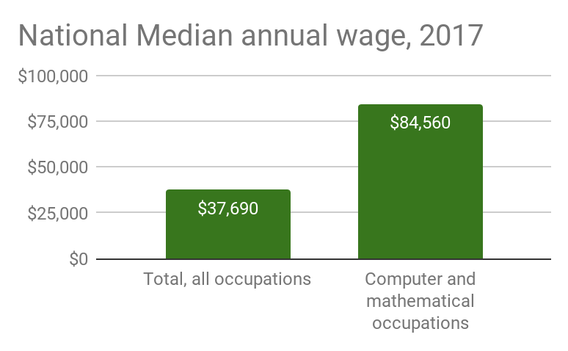
National Median Wage of IT related fields
Computer and Mathematical Occupations were 45% higher than the average occupation in 2017
Employment by major occupational group, 2016 and projected 2026:Table 1.1 Employment by major occupational group, 2016 and projected 2026
Computer and Mathematical

Slide 30
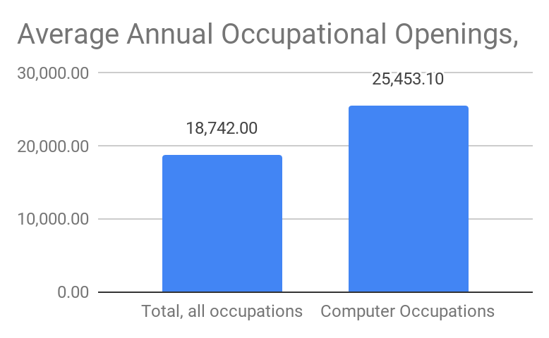
Average Annual Occupational Openings from 2016-2026
Computer occupations will have 26% greater openings in 2026 compared to the average occupational growth
Employment by major occupational group, 2016 and projected 2026: Table 1.2 Employment by detailed occupation, 2016 and projected 2026
Notes:
Employment by major occupational group, 2016 and projected 2026: Table 1.2 Employment by detailed occupation, 2016 and projected 2026

Slide 31
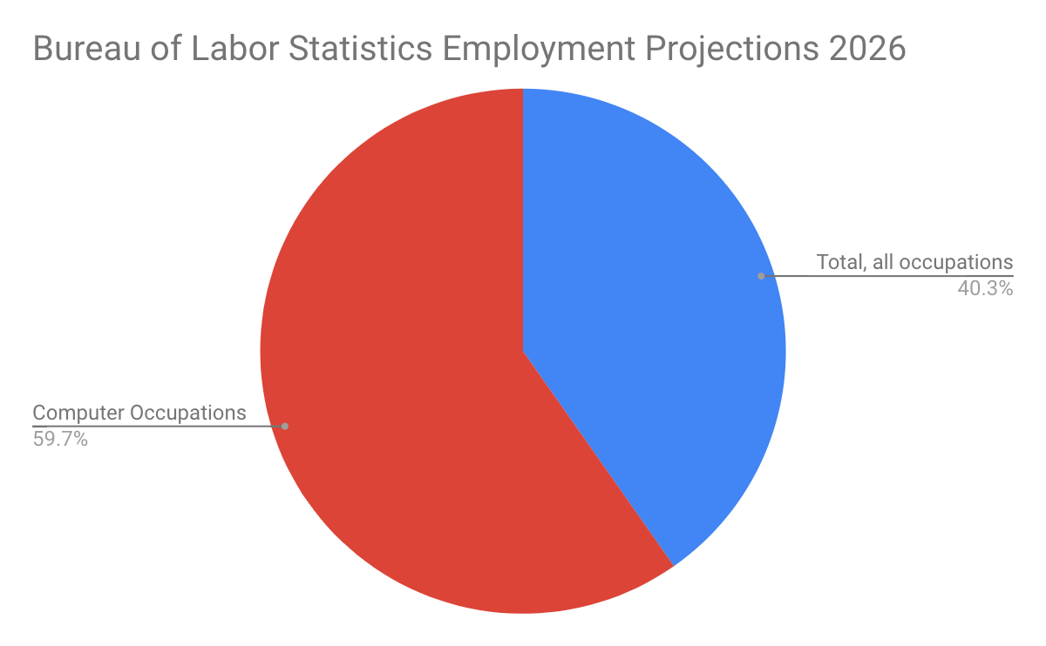
Projected Employment In 2026 By Occupation
60% of occupations is 2026 is projected to be computer related
Employment by major occupational group, 2016 and projected 2026: Table 1.2 Employment by detailed occupation, 2016 and projected 2026

Slide 32
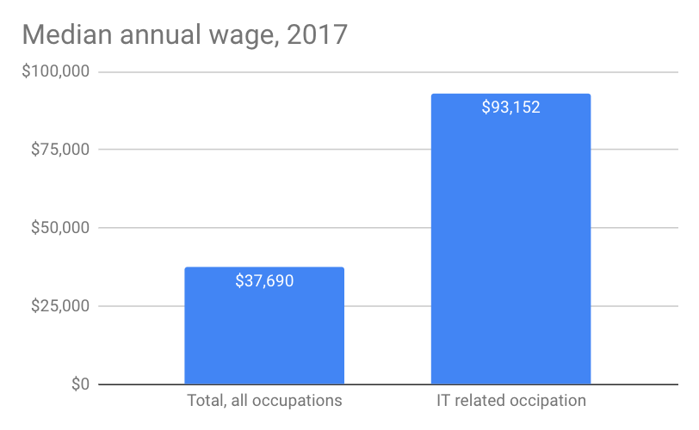
Median Annual Wage In 2017 For Top 30st Fastest Growing Occupations
IT related occupations were making $55,000 more that the average occupation in 2017
Employment by major occupational group, 2016 and projected 2026: Table 1.3 Fastest growing occupations, 2016 and projected 2026
Notes:
Average top 30 fastest growing occupations income in 2017 was $59,425 where IT jobs were $93,152
13-16% of the top 30 fastest growing occupations in the next 8 years is IT related

Slide 33
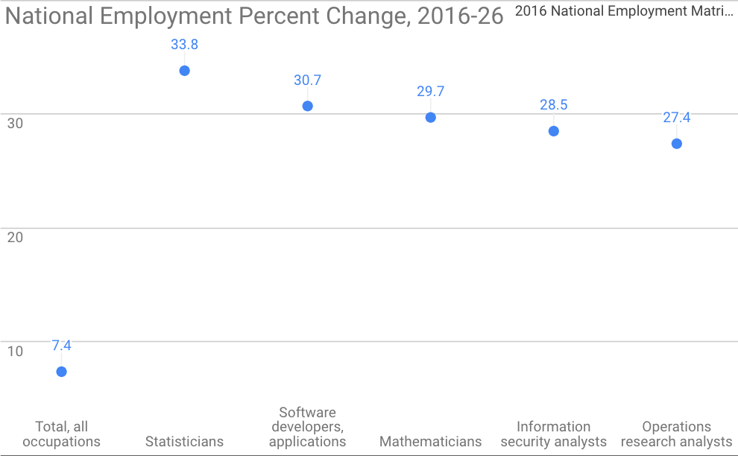
Projected Employment Increase For The Top 30 Fastest Growing Occupations In 2026
Between 13%-16% of of the top 30 fastest growing occupation from 2016-2026 are IT related fields
Employment by major occupational group, 2016 and projected 2026: Table 1.3 Fastest growing occupations, 2016 and projected 2026
Notes:
Between 13%-16% of of the top 30 fastest growing occupation from 2016-2026 are IT related fields
Table 1.3 Fastest growing occupations, 2016 and projected 2026

Slide 34
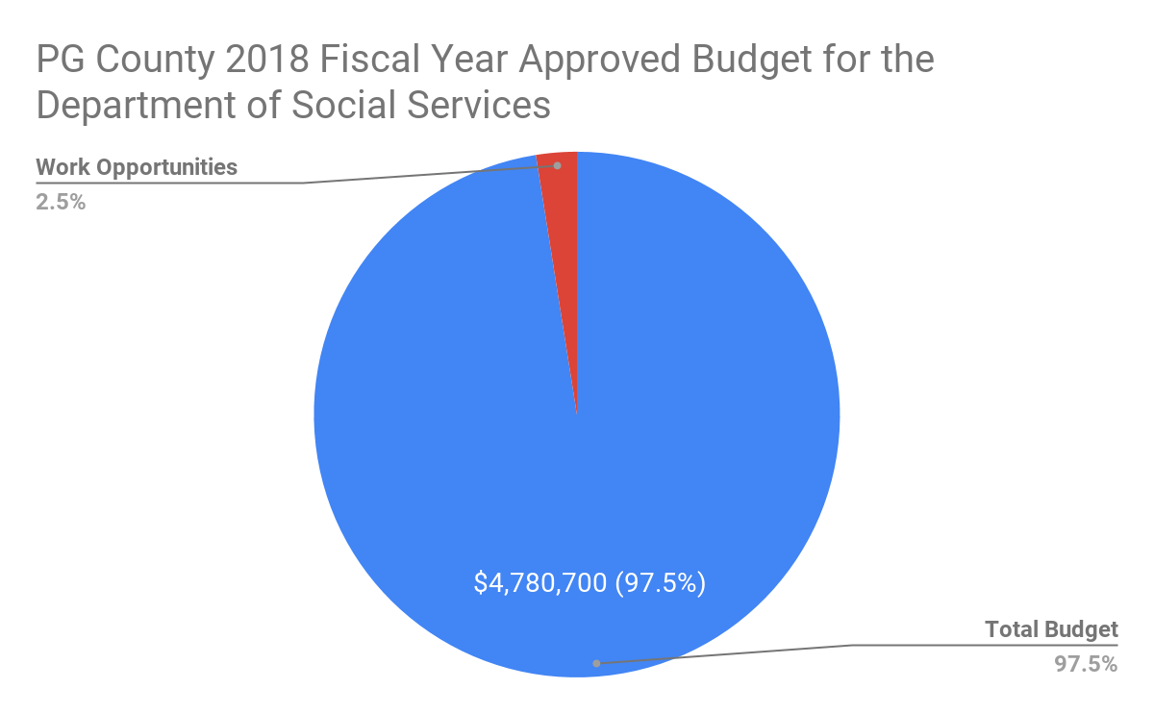
PG County’s Investment in Welfare Reform-Work Opportunities
2018 Fiscal Year Approved Budget for Department Of Social Services
Total Budget:
$4,780,700
Work Opportunities:
$122,500
We can see here that there is a clear minimal investment in work opportunity programs that would have a high ROI if directed correctly.
Notes:
2018 Fiscal Year Approved Budget for Department Of Social Services
Total Budget
$4,780,700
Work Opportunities
$122,500
2018 Fiscal Year Approved Budget for Grants
Total Budget
$202,733,500
Work Opportunities

Slide 35
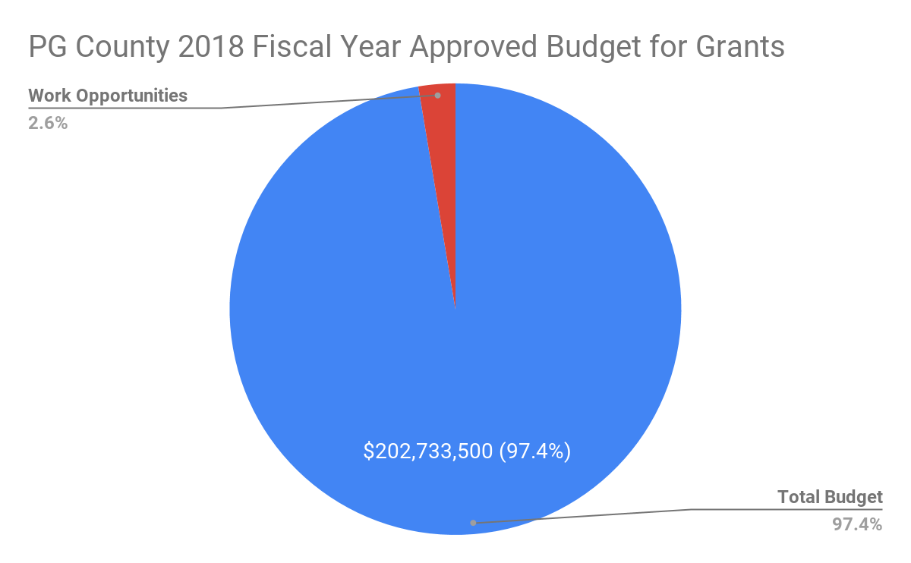
PG County’s Investment in Welfare Reform-Work Opportunities
2018 Fiscal Year Approved Budget for Grants
Total Budget:
$202,733,500
Work Opportunities:
$5,487,700
We can see here that there is a clear minimal investment in work opportunity programs that would have a high ROI if directed correctly.
Notes:
2018 Fiscal Year Approved Budget for Department Of Social Services
Total Budget
$4,780,700
Work Opportunities
$122,500
2018 Fiscal Year Approved Budget for Grants
Total Budget
$202,733,500
Work Opportunities

Slide 36
What decisions should be made based on our analysis?

Slide 37

The solution
“Aid programs that provide women opportunities to better their health, education, and well-being have effects far beyond a single individual. A woman multiplies the impact of an investment made in her future by extending benefits to the world around her, creating a better life for her family and building a strong community.” -USAID
Notes:
https://www.usaid.gov/infographics/50th/why-invest-in-women

Slide 38
PG County, College Park, and the MD State government can sustainably invest in short term education for WOC that would decrease the need for social dependency from the government ,effectively increasing the standard of living as well of quality of life for the whole DMV region

Slide 39
Potential Bootcamp Timeline
January 2019
June 2019
December 2019
March 2019
September 2019
Classes start
Students graduate program and receive certification(s)
Students are off any type of government assistance
Jan |  | Mar |  |  | Jun |  |  | Sept |  |  | Dec
Once general skills are met, job training begins
Students are fully integrated into the workforce

Slide 40

Invest in women!

